Slide 1



High Frequency Radio Team
(HFRT)
Skill Level 1
Place AS-2259 Antenna into Service

Slide 2
Purpose: The following slides gives basic instruction in the following
Skill Level 1 High Frequency Radio Team (HFRT) tasks as identified in
The HFRT Training and Evaluation Outline (T&EO):
Place AS-2259 Antenna into Service
Conditions: You are located in the desired position and with
the necessary equipment to erect the AS-2259 antenna.
Standard: The team after, completing the block of instruction, will
safely set up the antenna within 20 minutes.

Slide 3
Safety Briefing:
Never erect antennas less than 2 times its length close to energized power lines.
Never touch or be in close proximity to antennas when transmitting or burns could result.
Always ground equipment using proper grounding techniques.

Slide 4
General Antenna Siting Requirements
In addition to the safety requirement of staying away from energized power lines, be cognizant of the following:
Wide open areas will give better reception.
Closer proximity to power lines will increase possibility of interference.
The closer you are to buildings will reduce reception.
The distance your antenna can be away from the radio is determined by the length of your antenna coax and your tuner cables.
Site your antenna so your radio will have shelter from elements and electrical power (if available).

Slide 5
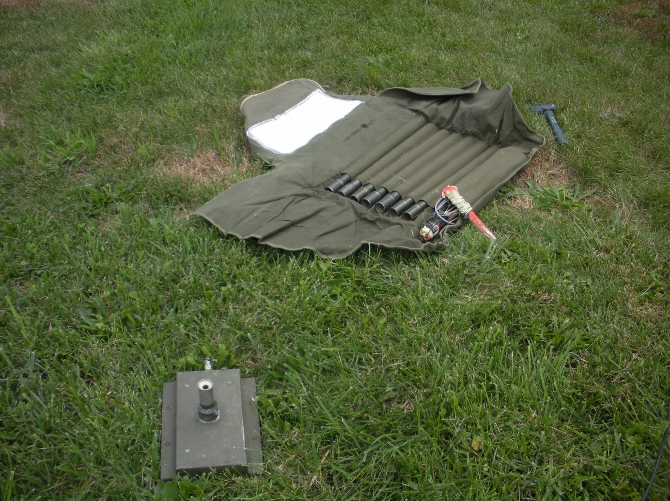
Step 1
Place antenna and base in desired location. Unroll bag. Have hammer ready.

Slide 6
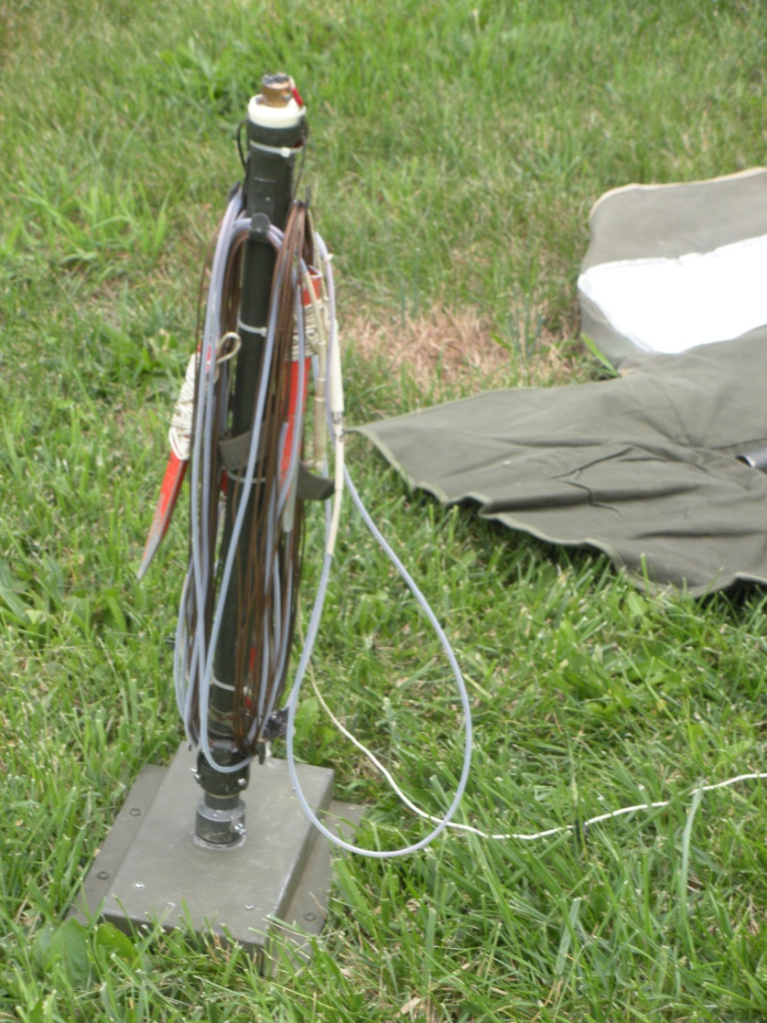
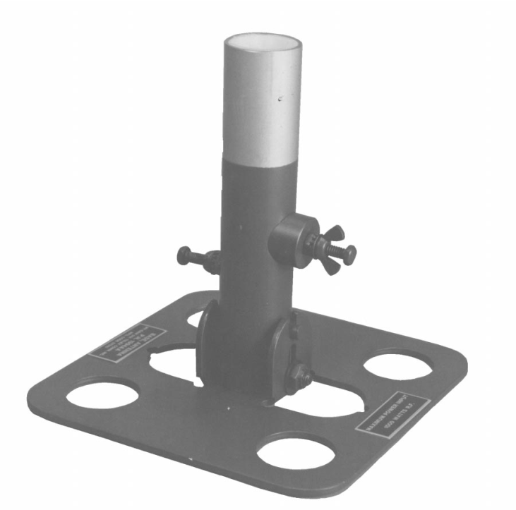
Step 2
Issue type base
Remove antenna head from bag and place on antenna base.

Slide 7
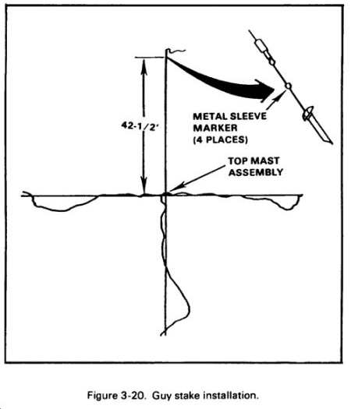
Step 3
Step 1
Unwind the antenna elements. They must not cross each other and radiate out in right angles to each other.

Slide 8
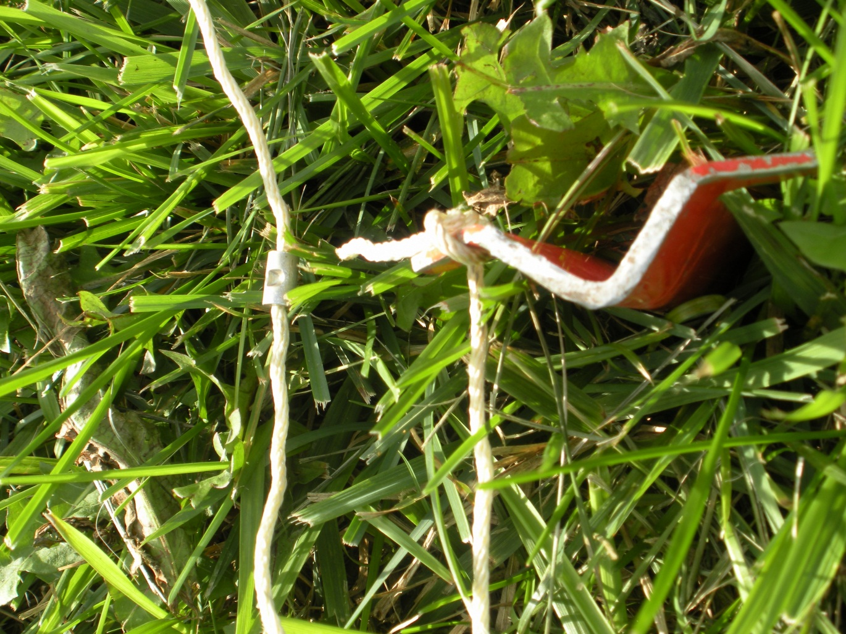
Step 2
Step 4
At the metal sleeve, hammer in the attached metal stake. Make sure the stake is secure! Do the same for the other three antenna legs.

Slide 9
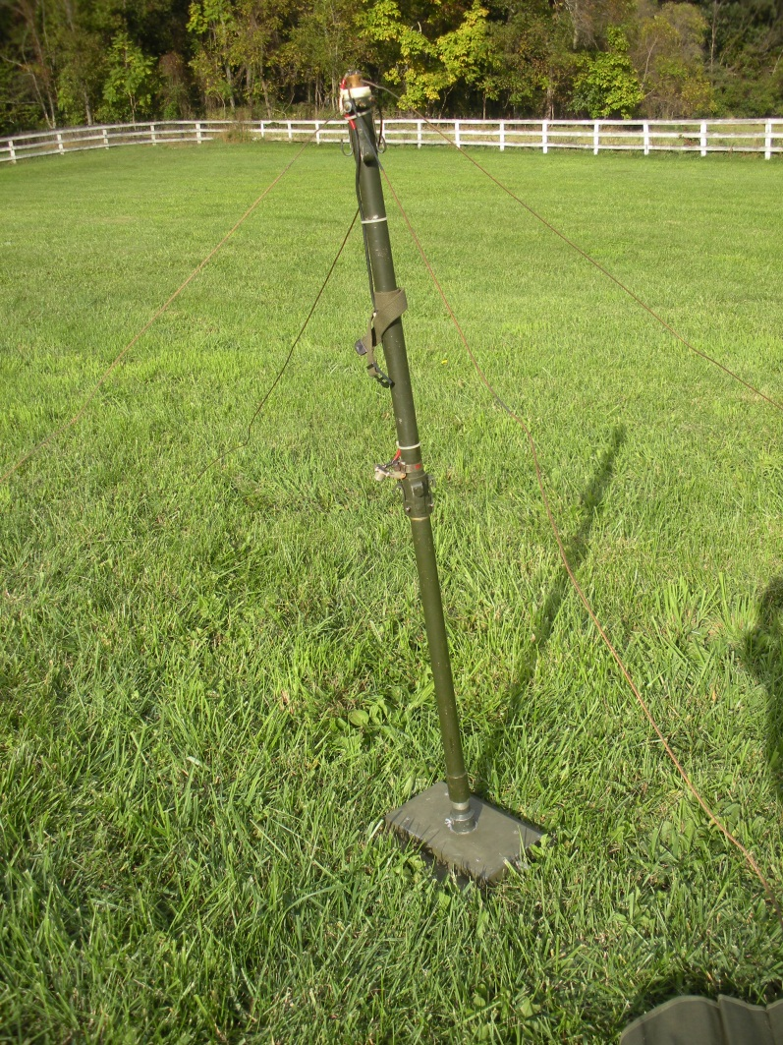
Step 5
Lift the antenna head off the base and insert a mast section between the antenna head and the base.

Slide 10
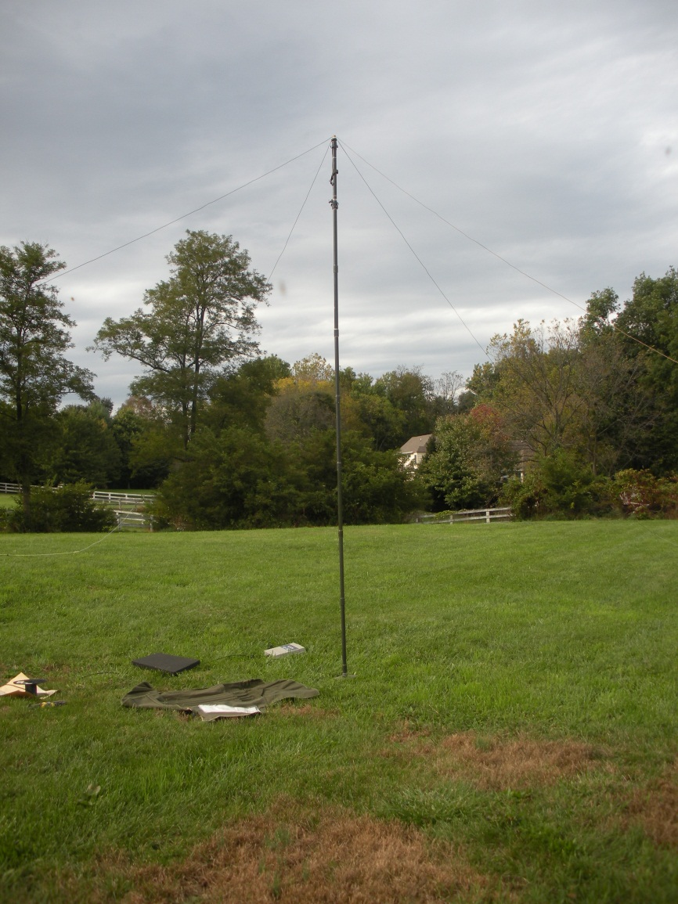
Step 6
Now insert the remaining mast sections
until the antenna is fully erect. It should
be self supporting at this stage.

Slide 11
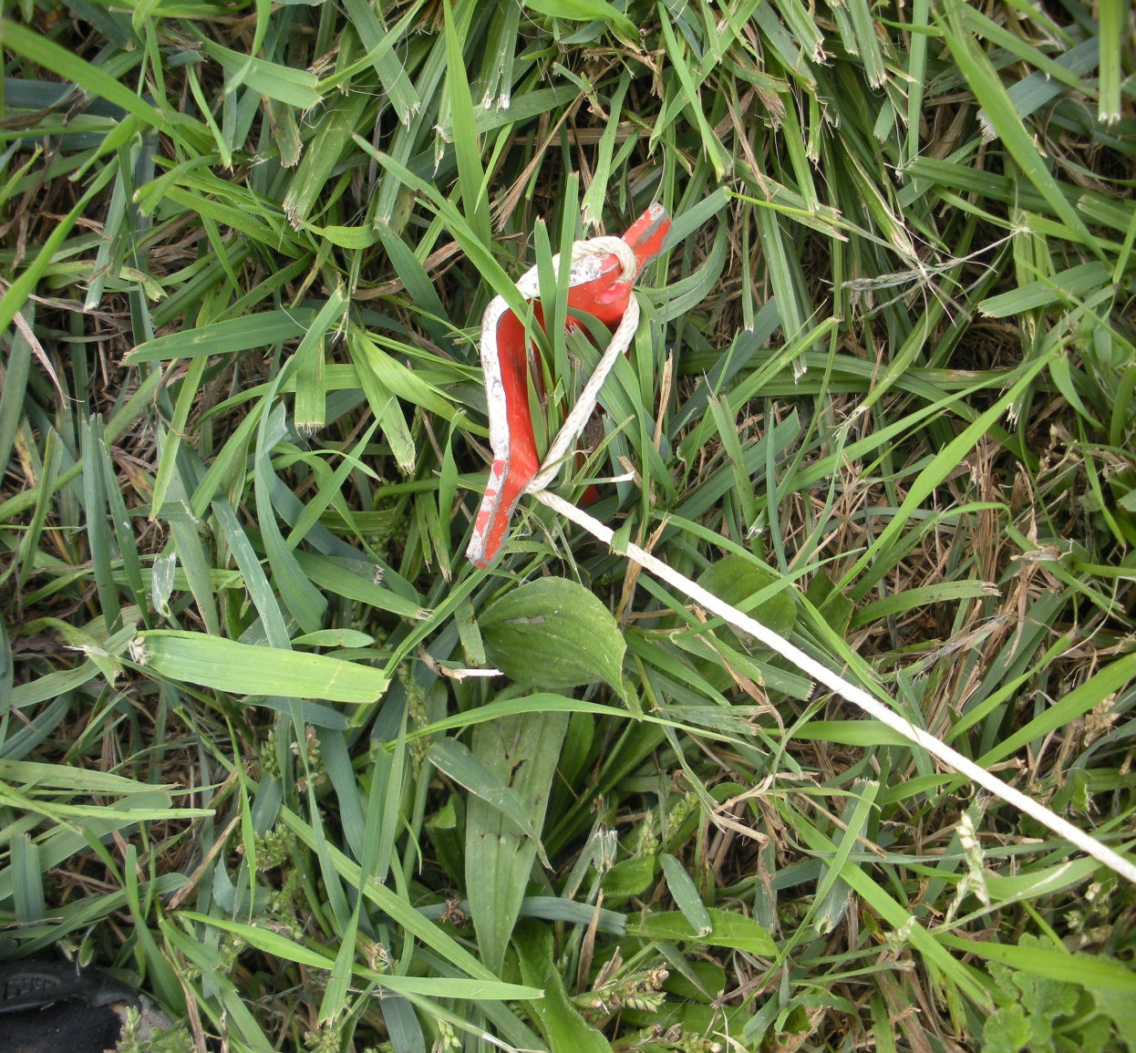
Step 7
If any antenna leads are too loose
tighten them by winding the cord
around the stake.
You only need
3 to 5 LBS of tension on the antenna lead.

Slide 12
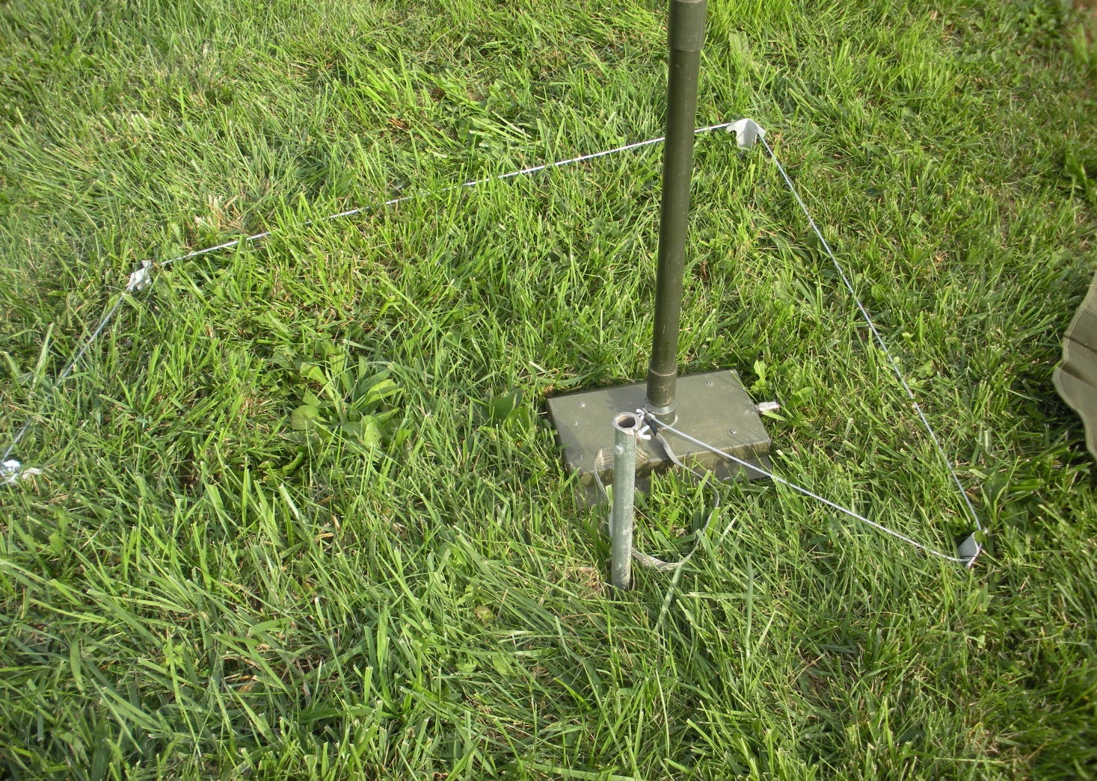
4 grounding stakes connected by
cable.
Grounding stake connected by braided cable.
Step 8
Ground the antenna using the provided ground stake and leads. Note that there are many different types of grounding methods available. General rule of thumb is that it’s better to have too much rather than too little grounding. Also, keep your grounding leads as short as possible. If ground is dry, soak with water to increase conductivity.

Slide 13
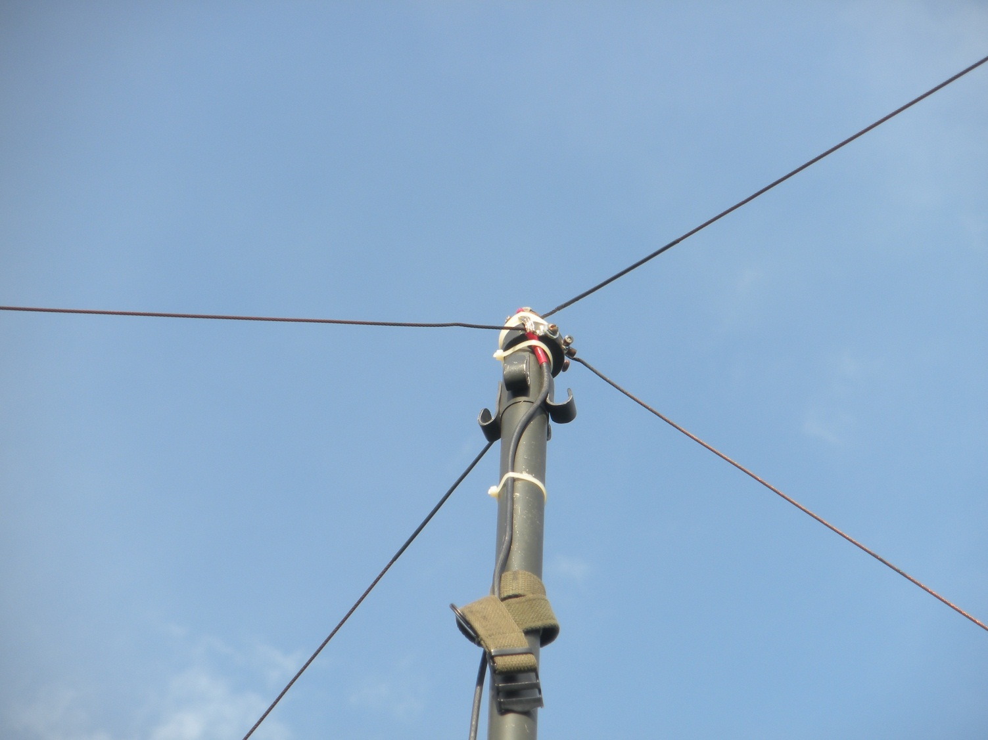
Step 9
Double check that your antenna leads are not crossed!

Slide 14
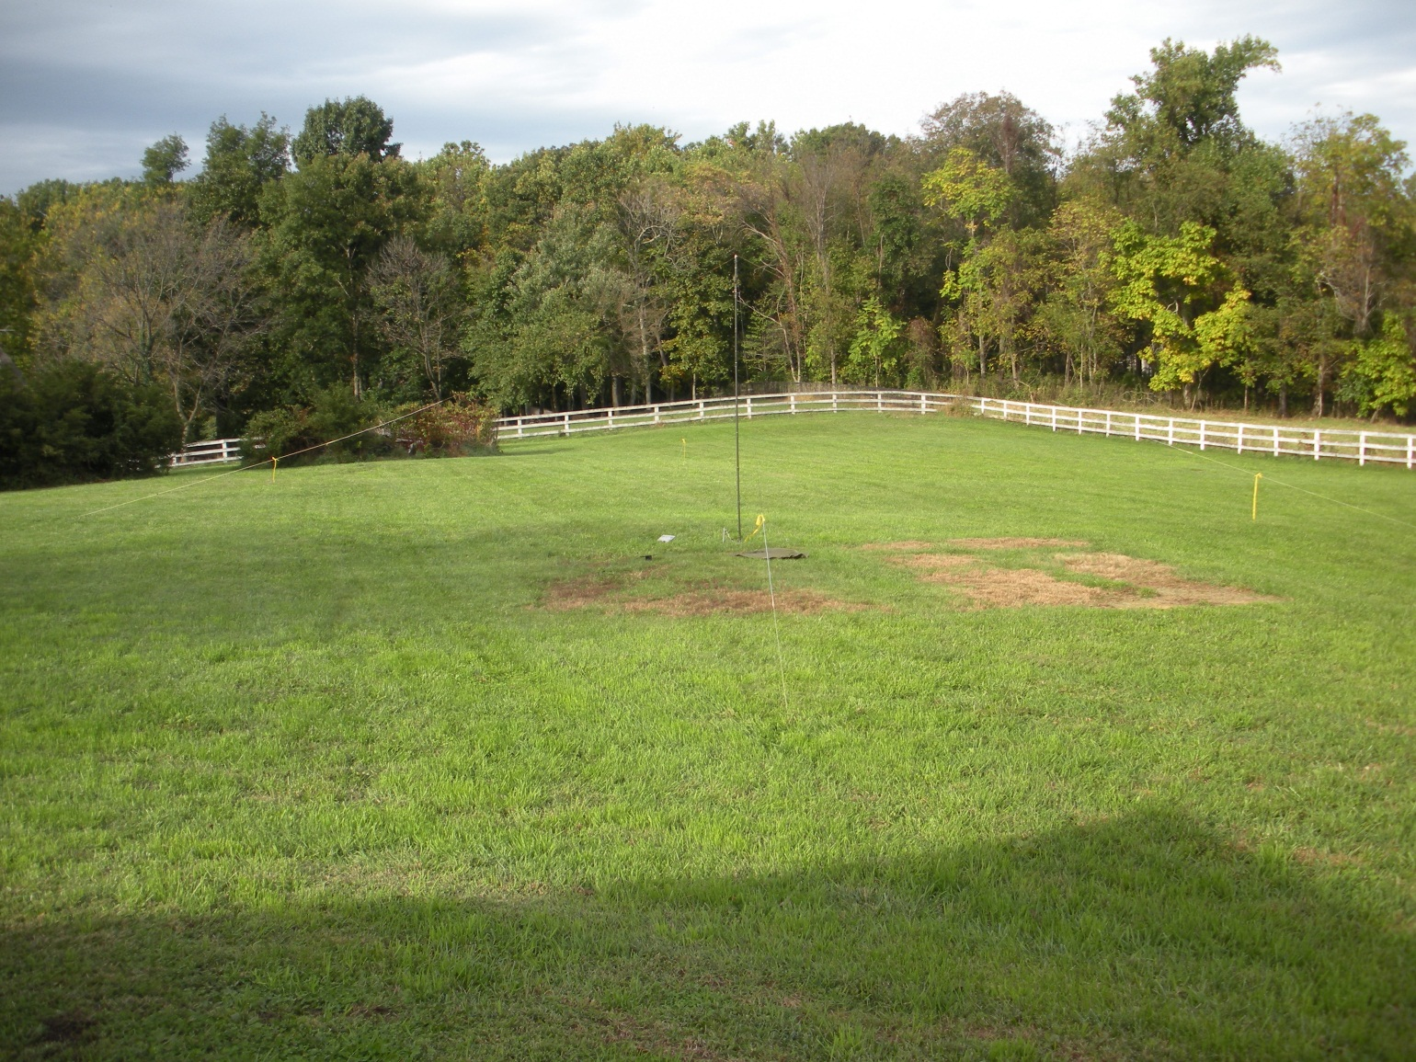
Step 10
Tie safety tape or ribbon to your antenna leads to prevent someone from walking into it. At night, it’s a good idea to put up chem lights if you have them.

Slide 15
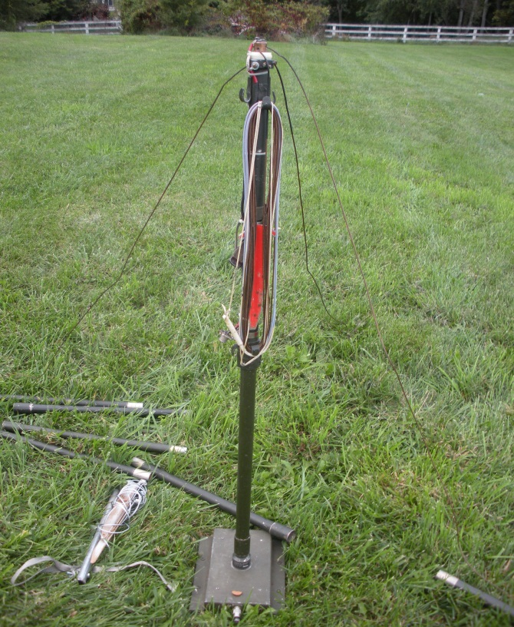
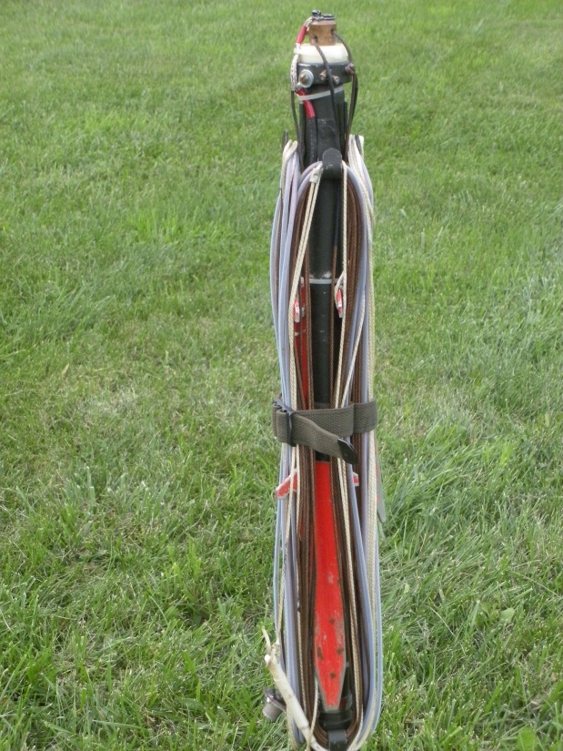
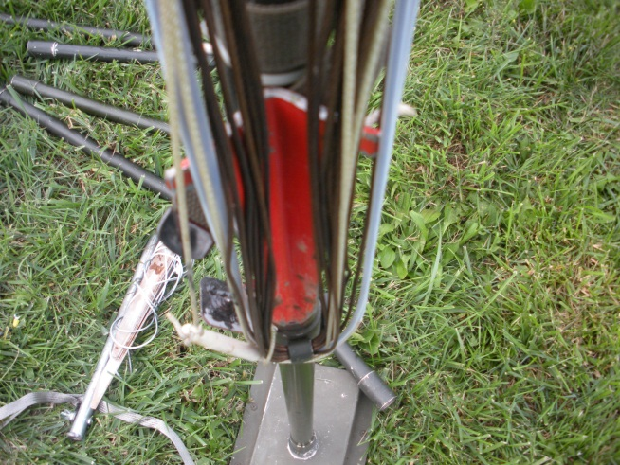
To Secure Antenna
1. Remove mast sections until you have one left. 2. Wind the antenna leads neatly on the hooks and secure the stake under the coiled lead. 3. Secure the antenna leads with the attached strap. Clean all dirt, mud, grass from the antenna parts and secure in the antenna roll. Neatness demonstrates a competent VDF trooper!
2.
1.
3.

Slide 16
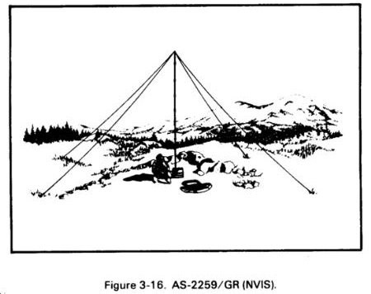
Task: Place AS-2259 Antenna into Service
Questions??

