Slide 1


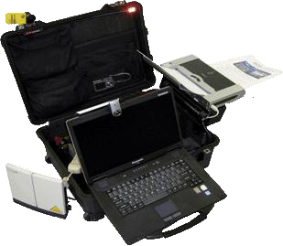
VIRGINIA DEFENSE FORCE
COM 102
IMAR Training

Slide 2
COM 102 Purpose
Action: Discuss TACPAK operations and equipment, IMAR team functions, and provide overview of emergency agencies with whom the VDF interacts
Conditions: Interactive classroom
Standard: Be able to recognize TACPAK for IMAR team deployment
*SILENCE CELLPHONES
*50/10 TIMEKEEPER
*SIGN IN FOR CREDIT
*TESTABLE
*SAFETY BRIEF
Notes:
Safety brief: Exits, weather notes/hydration/report illness immediately/report return home to COC if leaving after class

Slide 3
Course Objectives
At the completion of this period of instruction, you should be familiar with the following:
Identify key components of TACPAK & PITTPAK
Recognize VaNG & VDF associated agencies
Describe IMAR team deployment activities

Slide 4

Agenda
TACPAK INTRODUCTION
  Draw TACPAK FORM 2062 (Hand Receipt)
  TACPAK Overview
  TACPAK Set Up
Agency Introductions
  Virginia Emergency Operations Center (VEOC)
  Virginia Emergency Team (VERT)
  Emergency Support Functions (ESFs)
  Response Process
WEBEOC
  Core Functions
  Interface Introduction / Walk-thru
STATE ACTIVE DUTY (SAD) Discussion

Slide 5
TACPAK Introduction
Overview of TACPAK
  Draw TACPAK / Perform PMCS
  Inventory
    Power Management
    Computer WLAN and WiFi
    Printer / Scanner
    GPS / Video / Camera
    Telephony: Terr. & Sat.
    Skype and PolyCom
  TACPAK SETUP
Class Exercise: TACPAK Set-Up

Slide 6
TACPAK Introduction
Draw TACPAK and Perform PMCS
  Team leader signs for and shows VDF Form 2062 (Hand Receipt) for equipment.
  Team leader indicates what items are maintenance indicators and how to obtain required maintenance.
    DA Form 2404: Equipment Inspection And Maintenance Worksheet

Slide 7
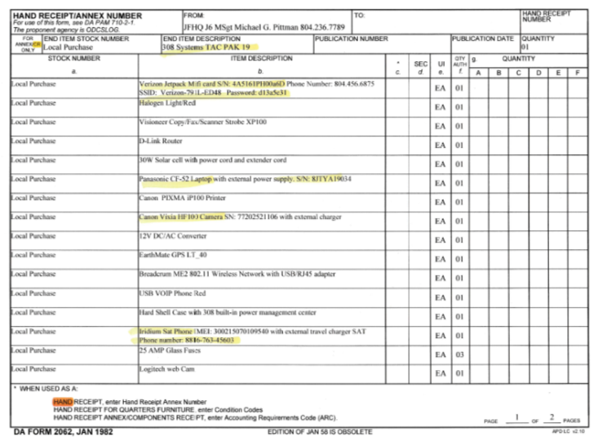
Draw TACPAK
Hand Receipt: DA FORM 2062

Slide 8
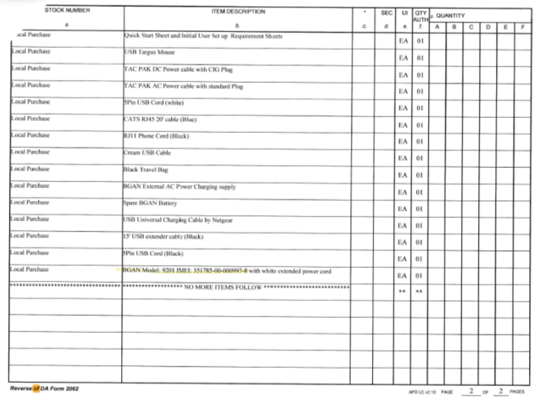
Draw TACPAK
Hand Receipt: DA FORM 2062

Slide 9
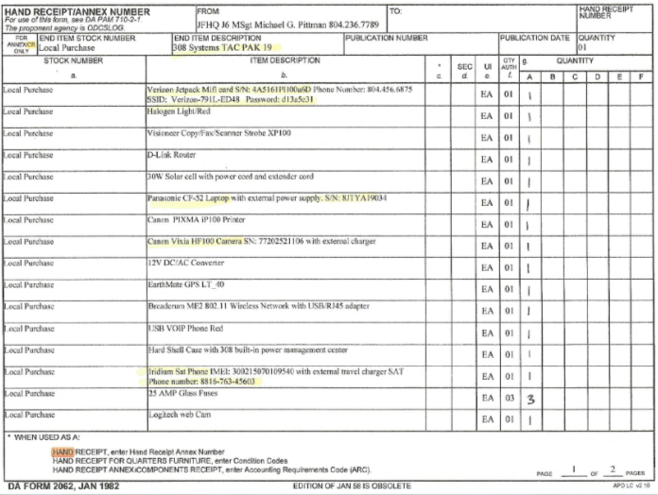
Draw TACPAK
Filling out Hand Receipt
Record Quantity of each item in Section G

Slide 10
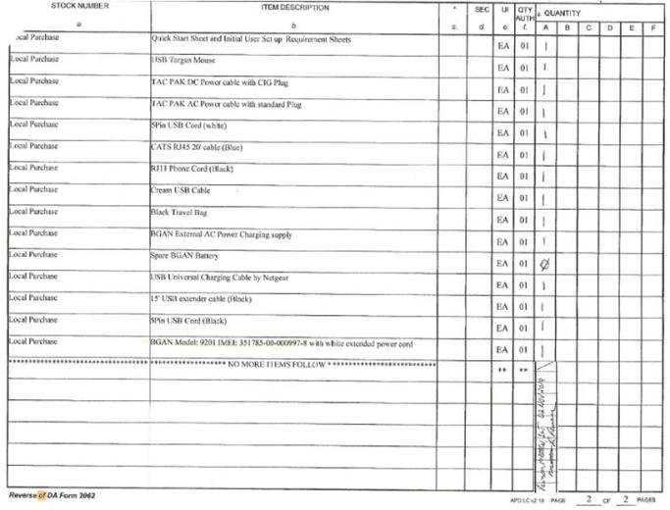
Draw TACPAK
Filling out Hand Receipt
Record Quantity of each item in Section G
Printed Last, First Name and Date
Underneath Place your signature

Slide 11
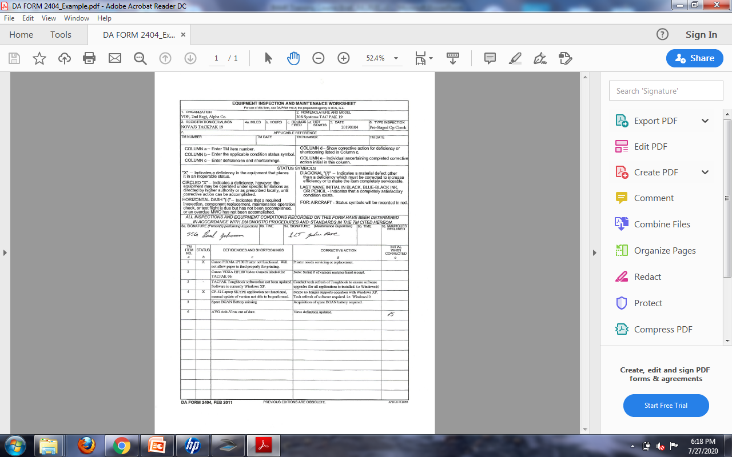
Perform PMCS
Equipment Inspection And Maintenance Worksheet
  DA Form 2404

Slide 12
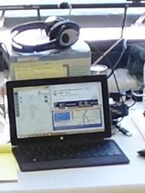
TACPAK Configurations
TACPAK “HEAVY”
TACPAK “LITE” (2016 Version)

Slide 13
TACPAK “Lite” Inventory
TACPAK “LITE” (2016 version)
  Surface Tablet
  Head Phones
  Mouse
  WIFI
  Cell Phone

Slide 14
TACPAK “Heavy” Inventory
INMARSAT BGAN Satellite Dish
Visioneer XP100 Copy/Fax/Scanner
D-Link Router
30W Solar Cell with cords
Panasonic CF-52 laptop computer
308 TAC-PAK Power Center
Canon Pixma iP90v Printer
Canon Vixia HF10 Camera
12V CD/AC Converter
EarthMate GPS LT-40
Iridium Satellite Phone
Logitech Web Camera
USB / RJ45 Adapter
TAC-PAK DC & AC plugs

Slide 15
Power Management
AC: 110 / 240 volt
DC: 10 – 34 volt
Car / vehicle
Solar Panel
Battery (8 hours)

Slide 16
Computer WLAN & WIFI
Hardened Laptop
Detachable for better ergonomics
Router
Wired / wireless ethernet
Battery
Pre-loaded pre-configured software

Slide 17
Computer WLAN & WIFI
Wired and Wireless switch/router
  Access and share data network
  Interface with local LAN
Cellular Air Card (Verizon)
  High Speed (12 Mps) if available
BGAN SATCOM Terminal
  Mid Speed (492 Kbs or 256 Kbs)

Slide 18
Printer & Scanner
Ink Jet Printer: B&W or Color
Scanner: 600 Dpi / 24-bit color
Copy: Scan then Print

Slide 19
GPS / Video / Camera
EarthMate GPS LT-40: air or ground mode
Canon Vixia Camera: video or still photos
SD Cards into Computer
Logitech WebCam

Slide 20
Telephony: Terr. & Sat.
Voice Over In6ernet Protocol (VoIP): Skype or Handset)
Iridium Satellite Phone (SATPhone): Handheld Phone
Broadband Global Area Network (BGAN) Satellite Communications (SATCOM)

Slide 21
Place TACPAK into Operation
BASIC STEPS
  Place TACPAK on Sturdy Flat Surface
  Open and Identify All Cables
  Connect All Power and Data Cables
  Turn on Master power Switch
  Power Up All Components

Slide 22
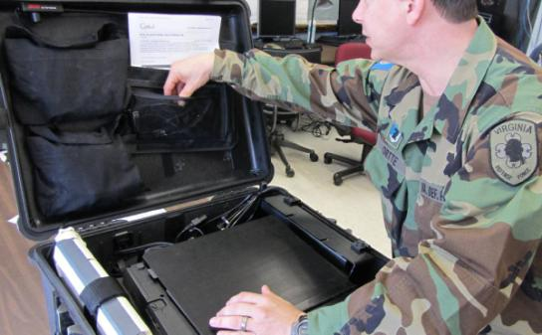
Place TACPAK into Operation
Place TACPAK on Sturdy Flat Surface
Open and Identify All Cables

Slide 23
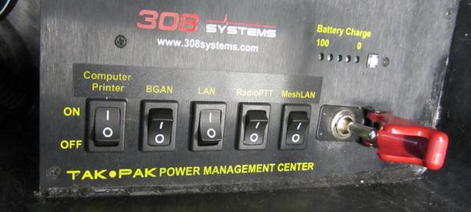
Place TACPAK into Operation
Connect All Power and Data Cables
Turn on Master Power Switch
Check TACPAK Battery Level

Slide 24
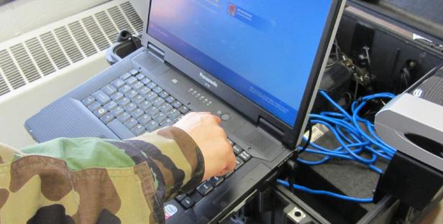
Place TACPAK into Operation
Establish Internet Connection
Ensure AirCard Inserted into Router
Connect Laptop through WiFi

Slide 25
Place TACPAK into Operation
OR Cable Router and Laptop
OR Insert AirCard into Laptop

Slide 26
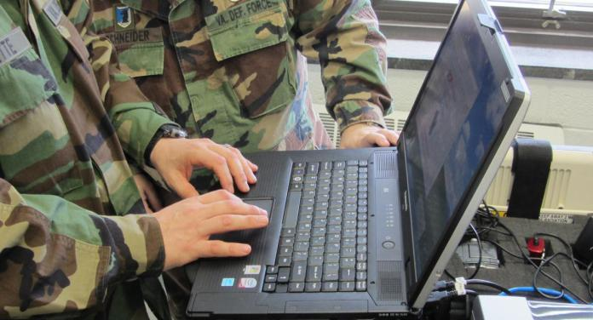
Place TACPAK into Operation
Local Area Network Connection Checks
  Test E-Mail Function
  Test Print and Scan Functions

Slide 27
End of Section
TAKE AT 10 MINUTE BREAK

Slide 28
TACPAK Setup
CLASS ACTIVITY

Slide 29
End of Section
TAKE AT 10 MINUTE BREAK

Slide 30
Agency Introductions

Slide 31
Agency Introductions
  Virginia Emergency Operations Center (VEOC)
  Virginia Emergency Support Team (VEST)
  Emergency Support Functions (ESFs)
  Response Process

Slide 32
Virginia Emergency
Operations Center (VEOC)
During normal operations, it is the responsibility of Virginia Department of Emergency Management (VDEM) to manage the Virginia Emergency Operations Center (VEOC).
  The VEOC hosts the Virginia Emergency Support Team (VEST) and the Commonwealth’s Emergency Support Functions (ESFs), which respond to calls for assistance from local governments throughout the Commonwealth
  The VEOC is not an incident command center; it is an incident coordination center.
The VEOC will be under control of the State Coordinator of Emergency Management, who reports directly to the Governor. The supporting staff is the VEST, which is comprised of other designated state agencies, nonprofit organizations, and designated private sector agencies.
  Members of the VEST coordinate to provide support to the on-scene local government representative
Source: THE VIRGINIA DEPARTMENT OF EMERGENCY MANAGEMENT (VDEM) VEOC 101/201 COURSE TRAINING MANUAL (01FEB2014)

Slide 33
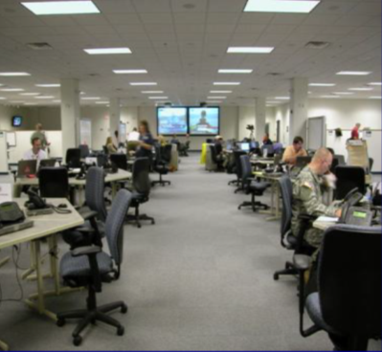
Virginia Emergency
Support Team (VEST)
  Coordinate response to disasters and emergencies throughout the Commonwealth when augmented
  Comprised of more than 300 credentialed members, the VEST draws its staff from more than 40 State Agencies, dozens of NGOs, and private sector companies such as Verizon and Dominion.
Source: https://www.vaemergency.gov/agency/veoc-vest/

Slide 34
Virginia Emergency
Support Team (VEST)
The VEST Coordinator will authorize a request for staffing of Sections and ESFs required for response to the incident/event
This request is communicated to VEST point of contacts by the VDEM Operations Section Chief via the Statewide Alert Network (SWAN)
VEST Section Chiefs and ESF group leaders will notify their personnel to respond to the VEOC, and provide a staffing plan to the VEST Operations Section Chief
Source: THE VIRGINIA DEPARTMENT OF EMERGENCY MANAGEMENT (VDEM) VEOC 101/201 COURSE TRAINING MANUAL (01FEB2014)

Slide 35
Emergency Support
Functions (ESFs)
Identified by the National Response Framework and Commonwealth of Virginia Emergency Operations Plan (COVEOP)
Provide structure for state interagency response
Comprised of:
  State departments and agencies
  Non-governmental organizations (NGOs)
In Virginia, the seventeen (17) Emergency Support Functions (ESFs) assign primary support and cooperating agencies and organizations for each function
  ESFs state agencies and non governmental agencies coordinate resources to ensure appropriate response and support during an incident or event
Source: THE VIRGINIA DEPARTMENT OF EMERGENCY MANAGEMENT (VDEM) VEOC 101/201 COURSE TRAINING MANUAL (01FEB2014)

Slide 36
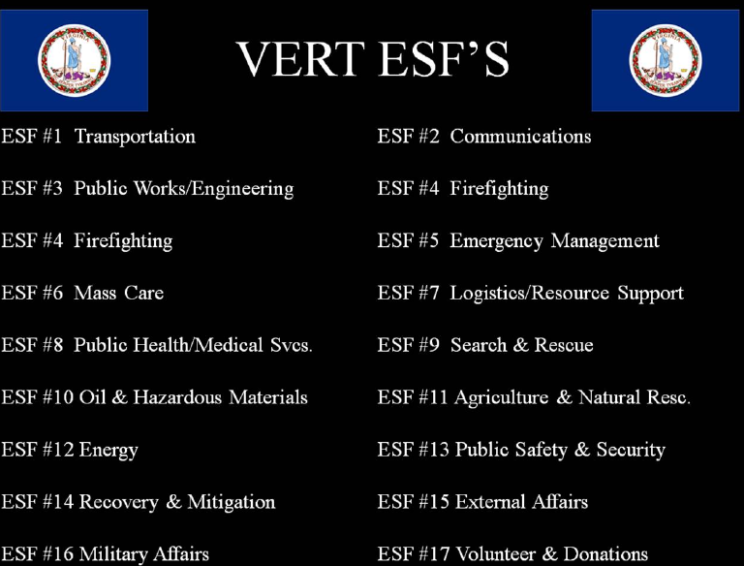
Emergency Support
Functions (ESFs)

Slide 37
ESF 16: Military Support
ESF and Support Agency | Scope of Work
ESF #16 – Military Support Primary – Military Affairs Support – Emergency Management; Virginia National Guard; Virginia Defense Force | Translate civilian missions into military missions Provide military resources Plan, coordinate, and control mission assignments and utilization of Virginia Militia
Source: THE VIRGINIA DEPARTMENT OF EMERGENCY MANAGEMENT (VDEM) VEOC 101/201 COURSE TRAINING MANUAL (01FEB2014)

Slide 38
Response Process
If the Commonwealth is impacted by an event, i.e. severe weather, an incident may be created in WEBEOC as a means of communicating with local governments.
The impacted local jurisdiction will begin to use WEBEOC to post Situation Reports (SitReps) and other pertinent information into the designated incident board.
During an event, it is the responsibility of the Planning Section to verify and collate information received into useful data for decision makers.
  Information is typically collected from local governments through SitReps, Initial Damage Assessments, and Shelter Boards.
During normal business operations, information is shared through the Virginia Emergency Operations Center (VEOC) Watch Center.
Additionally, during an event or incident requiring an augmentation of the Virginia Emergency Support Team (VEST), a Joint Information Center or JIC will be staffed.
It is the responsibility of External Affairs and Public Information Officers to ensure that the public receives timely and updated information to avoid any confusion and dispel rumors.

Slide 39
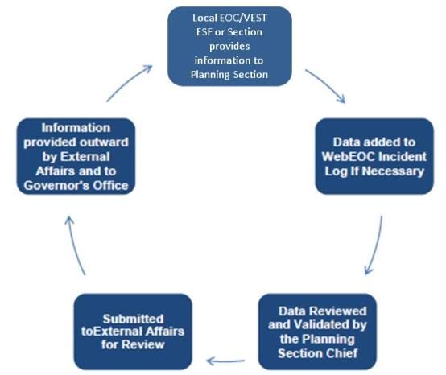
Response Process
COMMUNICATION AND INFORMATION SHARING PROCESS
Source: Introduction to the Virginia Emergency Response Team (VERT) and VDEM Crisis Management Systems (01FEB2014)

Slide 40
WEBEOC

Slide 41
WEBEOC Core Functions
Information Sharing - Facilitate real-time communications and information sharing between all responding and assisting parties, impacted localities, and federal partnerships during and after an emergency through many sources (IDA, SitRep, Position Log, GIS Capabilities).
Request Tracking - Effectively conduct essential response and recovery operations for any hazard or threat that may impact the Commonwealth of Virginia through resource management practices (Local and State Agency Requests for Assistance)
Source: Introduction to the Virginia Emergency Response Team (VERT) and VDEM Crisis Management Systems (01FEB2014)

Slide 42
WEBEOC Core Functions
Within WEBEOC, users have the capability to input, respond to, and track requests for assistance and resources deployed in connections with requests in an efficient and timely manner.
Users can also effectively exchange information both internally and externally between local, state, and federal partners.
Source: Introduction to the Virginia Emergency Response Team (VERT) and VDEM Crisis Management Systems (01FEB2014)

Slide 43
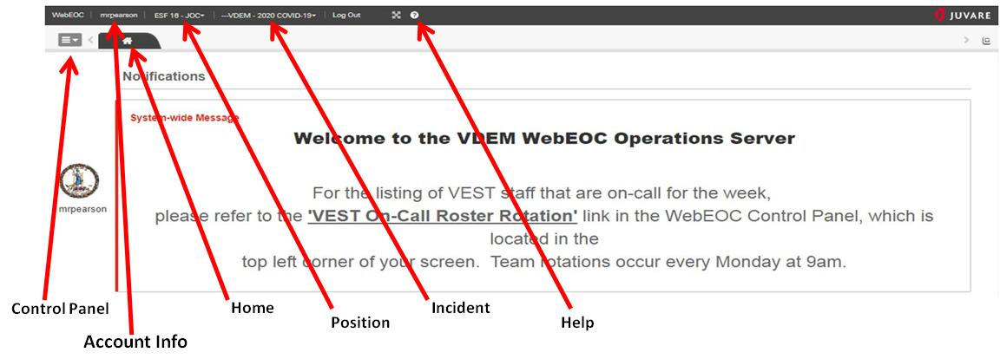
WEBEOC Interface
WEBEOC positions - purpose of each position
Department of Military Affairs (DMA) - Only persons ENTERING requests on BEHALF of DMA should have this access. This should be limited to those that have authority to request (potentially financially) on behalf of DMA
ESF 16- Military Affairs - This is the first touch for ESF 16 when requests get "tasked" to ESF 16. Only those with THIS position can see requests initially
ESF 16-JOC & ESF 16 - JTF - Those with ESF 16 Military Affairs have the ability to task to these 2 positions based off of VNG procedures

Slide 44
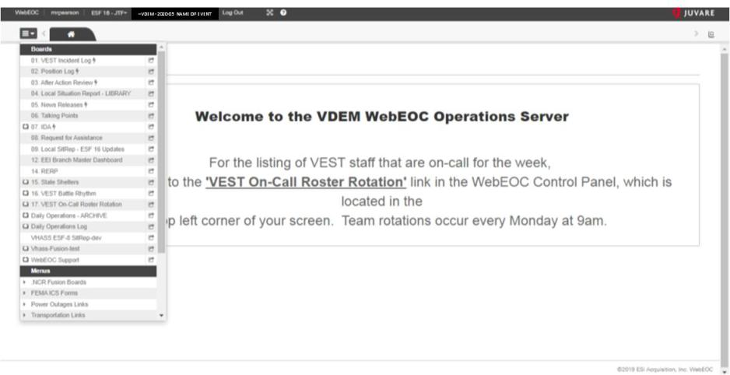
WEBEOC Interface
https://webeoc.vdem.virginia.gov/eoc7/default.aspx

Slide 45
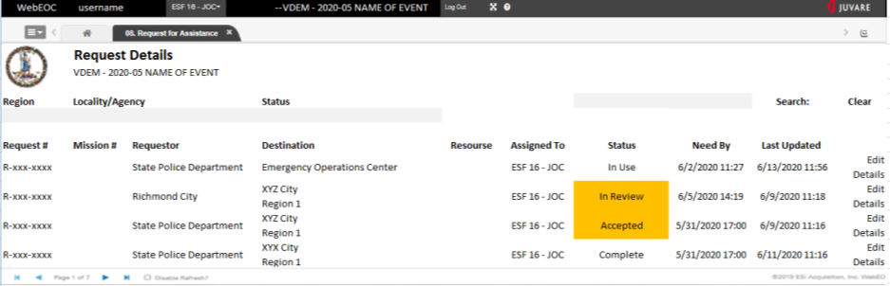
WEBEOC Interface
https://webeoc.vdem.virginia.gov/eoc7/default.aspx

Slide 46
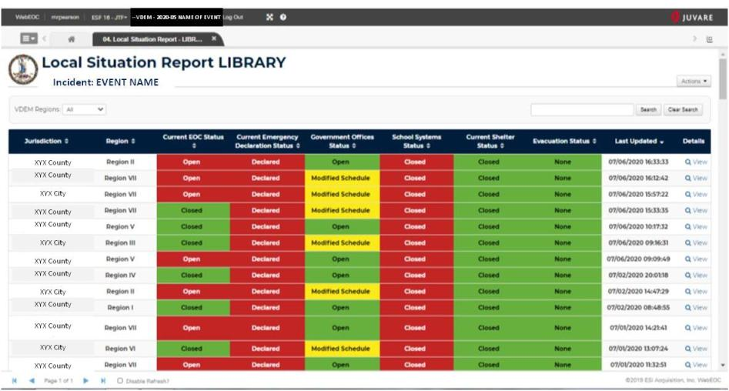
WEBEOC Interface
https://webeoc.vdem.virginia.gov/eoc7/default.aspx

Slide 47
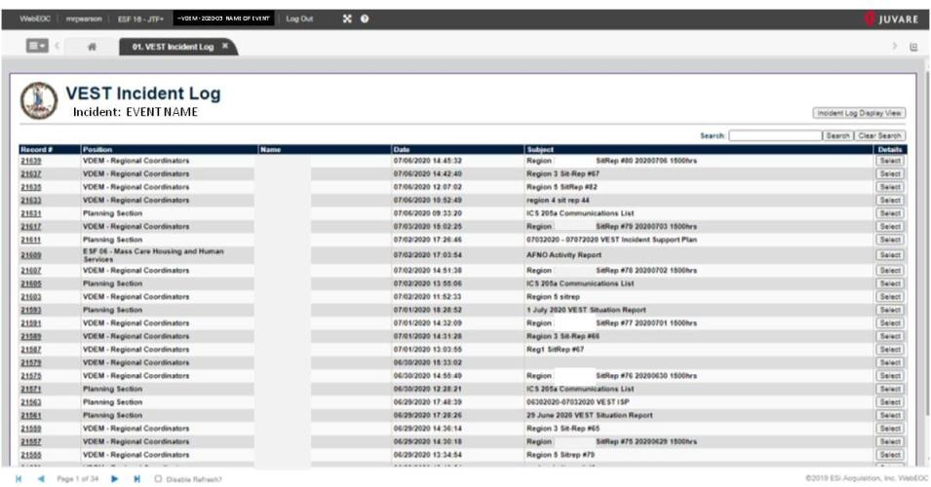
WEBEOC Interface
https://webeoc.vdem.virginia.gov/eoc7/default.aspx

Slide 48
WEBEOC Request Status
Request Statuses: A request does not become a mission until it is accepted by an ESF.
Submitted: This is a default notification assigned when a requestor has submitted a request for assistance to the VEOC. It serves as a notification that the request needs to be reviewed by Operations Staff for the CSALTT format, processed, and then tasked to an ESF. Only the requestor and the Request Management Group can view this status.
Tasked: The Tasking function notifies the ESF work group a request for assistance has been tasked to their respective work group for review.
In Review: This notification term tells the viewer the request for assistance is being reviewed by the assigned ESF work group. This means the ESF work group is evaluating the request against their potential resources. Requests should only be ―in review‖ for a short period of time.
Declined: If an ESF cannot fulfill the request for assistance. The reason for declining will be documented in the comments section of the request. Some examples of this are ―resources not available‖, or ―not a function of this ESF‖. This status does not mean that the request is not being filled. It may also represent an improperly assigned request which needs re-tasking.
Source: THE VIRGINIA DEPARTMENT OF EMERGENCY MANAGEMENT (VDEM) VEOC 101/201 COURSE TRAINING MANUAL (01FEB2014)

Slide 49
WEBEOC Mission Status
Mission Status
Accepted: This tells the viewer the ESF work group has reviewed the request, accepted the mission based on their resource capabilities, and is currently working the mission. When this status is applied, a phone call may be made by the ESF representative to the requestor stating the mission has been accepted based on the provided request information and scope of work.
In Transit: This term tells the viewer that the requested resource has been located and the resource is in route to the designated delivery location. When this status is applied a phone call will be made by the ESF representative to the requestor stating the resource is in route.
Delivered: Tells the viewer that the resource requested has arrived at the designated location. This status should only be used when personnel and/or resource has arrived at the location, but has not started work. Once work has begun, the status should be updated to In Use.
In Use: Indicates the resource is on scene and being used to meet the needs outlined in the request for assistance.
Source: THE VIRGINIA DEPARTMENT OF EMERGENCY MANAGEMENT (VDEM) VEOC 101/201 COURSE TRAINING MANUAL (01FEB2014)

Slide 50
WEBEOC Website Links
Operation Server
https://webeoc.vdem.virginia.gov/eoc7/default.aspx
Training Server
https://webeoctraining.vdem.virginia.gov/eoc7/
NOTE: WEBEOC passwords are now set to expire every 90 days. Previously the expiration was every 60 days.

Slide 51
End of Section
TAKE AT 10 MINUTE BREAK

Slide 52
SAD Discussion

Slide 53
SAD Mission Discussion
KEY DOCUMENTS
  Personnel Administration Forms
  VDF State Active Duty (SAD) Activation Orders
    W4 / VA4 Tax Forms
      Filled out electronically
      Must be Hand Signed in signature blocks
    Expense Report Forms
  Mission Execution
    PERSTATREP
    GENERAL MESSAGE (ICS 213)
    Activity Log (ICS 214)
    DA Form 2404 (Equipment Inspection And Maintenance Worksheet

Slide 54
SAD Mission Discussion
IMAR Team: Mission Support Concept
  Augment a local Emergency Operations Center (EOC) and serve as liaison in requests of Emergency Support Function (ESF) #16 Military Support.
  Deploy directly to a VaNG armory or staging area to facilitate flow of information between commander / task force HQ and the Joint Operations Center (JOC)
    TASK FORCE LEVEL: VANG Armory or State/Local Agency
    JOINT OPERATION CENTER LEVEL: VANG Defense Supply Center Richmond (DSCR)

Slide 55
SAD Mission Discussion
Example: TASK FORCE and/or JOC STRUCTURE
Key Note: On arrival at reporting location, identify and establish communication with the Battle CPT and BTL NCO
Position | Day |  | Night
Dep J3
OIC
NCOIC
Planner
BTL CPT
BTL NCO
LNO
RTO
VDF
Personnel

Slide 56
SAD Mission Discussion
Example: TASK FORCE and/or JOC Battle Rhythm
TIME | FREQ |  | EVENT | AUDIO | VISUAL
0700 | Daily |  | Shift Change Brief | TBD
0730 | Mon/Thurs |  | COS Sync | xxx-xxx-xxxx PIN: xxxx xxxx
0900 | Weekly | Mon/Fri | Staff Sync | P: WebEx Cloud: xxx-xxx-xxxx PIN: xxx xxx xx # A: DCS: xxx-xxx-xxxx PIN: xxx xxx xx # C: WebEx Standard: xxx-xxx-xxxx PIN: xxxx xxxx # E: n/a at this time | P: WebEx Cloud: https:// web link A: DCS: https:// web link C: n/a at this time E: n/a at this time
0900 | Weekly | Wed | Weekly Senior Leader Brief
1100 | Daily | Except Sun | OPS Sync
1430 | Daily | Except Wed | Situation Update Brief
1500 | Weekly | *Tues | COS BUB | xxx-xxx-xxxx PIN: xxxx xxxx
1600 | Daily |  | J3/G3 orders Sync | xxx-xxx-xxxx PIN: xxxx xxxx | APAN: https:// web link
1800 | Daily |  | J3 Order Published
1900 | Daily |  | Shift Change Brief | TBD
1900 | Daily |  | G3 Order Published

Slide 57
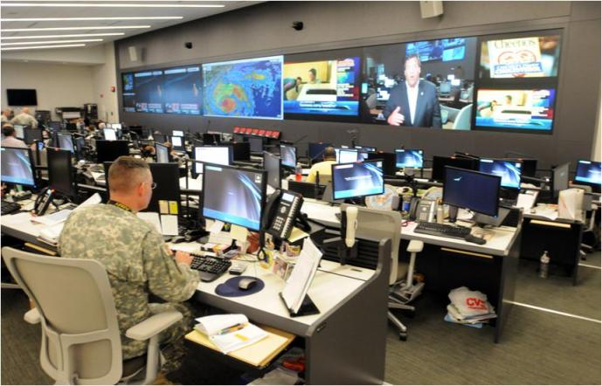
SAD Mission Discussion
Example: JOC Setup / Mission Tracking
With about 101,000 National Guard members ready to assist eastern seaboard states in the path of Hurricane Irene, Guardsmen at the National Guard Coordination Center in Arlington, Va., seen here Aug. 26, 2011, are monitoring the storm and National Guard support to civilian authorities around the clock. (U.S. Army photo/Staff Sgt. Jim Greenhill)
Source: https://www.af.mil/News/Article-Display/Article/112485/irene-national-guard-center-coordinates-joint-support-to-civilian-authorities/

Slide 58
SAD Mission Discussion
REQUEST FOR ASSISTANCE FLOW
MUNICIPALITY
RCC / VANG LNO, VDF RLR / IMAR
VDEM / VEST
ESF-16
VANG Task Force
(Brigade)
JFHQ JOC
IMAR
VANG
Battalions
VDF IMAR/HF/STARS
VANG Armory

Slide 59
                Questions?

